Slide 1
Data Cleaning and EDA
LECTURE 7
Exploratory data analysis and its role in the data science lifecycle.
Sean Kang

Slide 2
Review Pandas and Jupyter Notebooks, Data Structures, Data Types
Reviewing DataFrame concepts
Series: A named column of data with an index
Indexes: The mapping from keys to rows
DataFrame: collection of series with common index
Dataframe access methods
Filtering on predicts and slicing
df.loc: location by index
df.iloc: location by integer address
groupby & pivot aggregating data

Slide 3
Granularity, Scope, and Temporality

Slide 4
Key Data Properties to Consider in EDA
Structure -- the “shape” of a data file – how many columns, how many rows?
Granularity -- how fine/coarse is each datum – is it actual record, or summary
Scope -- how (in)complete is the data – all 100% of US citizens in US Census?
Temporality -- how is the data situated in time – The data might be just for 2010
Faithfulness -- how well does the data capture “reality” – was the census answered truthfully?

Slide 5
Granularity
Rec. 1
Rec. 1
Rec. 2
Rec. 3
Rec. 1
Rec. 2
Rec. 3
Fine Grained
Coarse
Grained
What does each record represent?
Examples: a purchase, a person, a group of users
Do all records capture granularity at the same level?
Some data will include summaries (aka rollups) as records
If the data are coarse how was it aggregated?
Sampling, averaging, …
Notes:
Coarse data at the usa, and then state by state level
https://www.census.gov/data/datasets/2022/econ/apes/2022.html

Slide 6
Scope
Does my data cover my area of interest?
Example: I am interested in studying crime in California but I only have Berkeley crime data.
Is my data too expansive?
Example: I am interested in student grades for DS100 but have student grades for all statistics classes.
Solution: Filtering ⇒ Implications on sample?
If the data is a sample I may have poor coverage after filtering …
Does my data cover the right time frame?
More on this in temporality …
Notes:
This contains only San Diego data
https://data.sandiego.gov/datasets/parking-meters-locations/
But if you wanted the whole California, you woud need a different source.
Too expansive – looking back at the US census data for all municipals over the whole USA. But maybe you only needed California.

Slide 7
Temporality
Data changes – when was the data collected?
What is the meaning of the time and date fields?
When the event happened
When the data was collected or recorded?
The data was copied into the database
Time depends on where – timezone, daylight savings
Learn to use datetime in python
Various string representation of the date (YY/MM/dd)
Are there any null or or strange values, or number of milliseconds since Epoch
Periodicity patterns – max or min temperature of a day
Notes:
0 date in Unix systems
https://currentmillis.com/
Periodicity can be annual, instead of just within 24 hours.
https://www.britannica.com/place/Gobi/Climate
The Gobi dessert has patterns over the year.

Slide 8
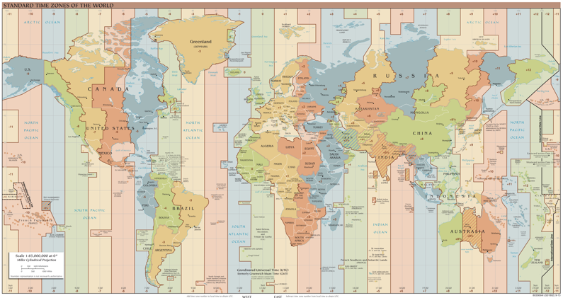
Unix Time / POSIX Time
Time measured in seconds since January 1st 1970
Minus leap seconds …
Unix time follows Coordinated Universal Time (UTC)
International time standard
Measured at 0 degrees latitude
Similar to Greenwich Mean Time (GMT)
No daylight savings
Time codes
Time Zones:
San Francisco (UTC-8) without daylight savings
https://en.wikipedia.org/wiki/Coordinated_Universal_Time
Notes:
Year 2038 problem 🡪 32 bit signed time wraps around.

Slide 9
Faithfulness and Missing Values

Slide 10
Faithfulness: Do I trust this data?
Does my data contain unrealistic or “incorrect” values?
Dates in the future for events in the past
Locations that don’t exist
Negative counts
Misspellings of names
Large outliers
Does my data violate obvious dependencies?
E.g., age and birthday don’t match
Was the data entered by hand?
Spelling errors, fields shifted …
Did the form require fields or provide default values?
Are there obvious signs of data falsification:
Repeated names, fake looking email addresses, repeated use of uncommon names or fields. (joe@universe.com)

Slide 11
Signs that your data may not be faithful
Missing Values/Default values?
What do they look like?
“ “,
0,
-1, 999, 12345,
NaN, Null, (NaN – Not a Number)
1970, 1900
Notes:
Negative numbers, large outliers, failed parsing …

Slide 12
More signs that your data may not be faithful
Missing Values or default values
Truncated data (early excel limits: 65536 Rows, 255 Columns)
Soln: be aware of consequences in analysis ⇒ how did truncation affect sample?
Time Zone Inconsistencies
Soln 1: convert to a common timezone (e.g., UTC)
Soln 2: convert to the timezone of the location – useful in modeling behavior.
Duplicated Records or Fields
Soln: identify and eliminate (use primary key) ⇒ implications on sample?
Spelling Errors
Soln: Apply corrections or drop records not in a dictionary ⇒ implications on sample?
Units not specified or consistent
Solns: Infer units, check values are in reasonable ranges for data
Others…
Notes:
Negative numbers, large outliers, failed parsing …
I worked on MS Office. I did not realize about this row limit of excel 2003.
https://learn.microsoft.com/en-us/sql/reporting-services/report-builder/work-around-the-excel-2003-row-limitation?view=sql-server-ver16

Slide 13
What to do with the Missing Values?
Drop records with missing values
Probably most common
Caution: check for biases introduced by dropped values
Missing or corrupt records might be related to something of interest
Imputation: (Inferring missing values)
Mean Imputation: replace with an average value
Which mean? Often use closest related subgroup mean.
Hot deck imputation: replace with a random value
Choose a random value from the subgroup and use it for the missing value. (See note for details article. Contents of that article are not covered in exam, but this desk will be covered.)
Notes:
https://medium.com/@cyberdud3/mastering-missing-data-in-python-tips-for-data-scientists-8662d93945a1
There is an indepth approach about handling missing data within data science.

Slide 14
Revisiting the Sampling Frame
The sampling frame is the population from which the data was sampled.
Note that this may not be the population of interest.
How complete/incomplete is the frame (and its data)?
How is the frame/data situated in place?
How well does the frame/data capture reality?
How is the frame/data situated in time?
Notes:
Looking back at the baby names, look at the size of names per year, or look at the time frame of that data set, or that that data seem to come from what part of the world?
Looking at the US Census data, it was for 2022. It wont show any historical trends.
The city of San Diego street meter data is just for San Diego.

